Slide 1
Vulcan Defect Status
July. 04, 2016
Tao Wu, Wen Yi Gao

Slide 2
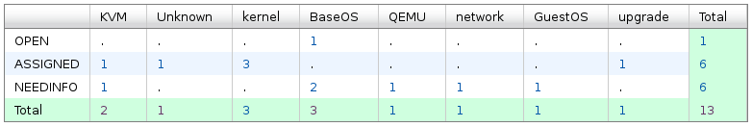
Vulcan - Open Defects
13 open defects excluding 4 HVM bugs.
1 new defect was opened in the last two weeks. We solved 3 defects in the past two weeks.
Defect statistics:

Slide 3
Vulcan – High Priority Defects
No | ID | Pri | Sev | Comp | Summary | Status | Comment
1 | 136145 | P1 | High | upgrade | kvmibm-upgrade-system -y upgrading Kronos FP1 to Vulcan RC2, hangs running: lvm lvs --noheadings -o vg_name /dev/mapper/s93kvh--fp--zkvmvg-root | ASSIGNED | - Expert on LVM from MCP team is investigating this bug.
2 | 140835 | P2 | High | Unknown | User process fault: interruption code 0x40011 in multipathd while booting Vulcan FP2 | ASSIGNED | - Looking for someone to investigate this bug.
3 | 138342 | P3 | High | kernel | Kernel stack overflow | ASSIGNED | - Under investigation.

Slide 4
Vulcan – All Defects
447 defects excluding 4 HVM defects opened in the Vulcan Bugzilla until now.

Slide 5
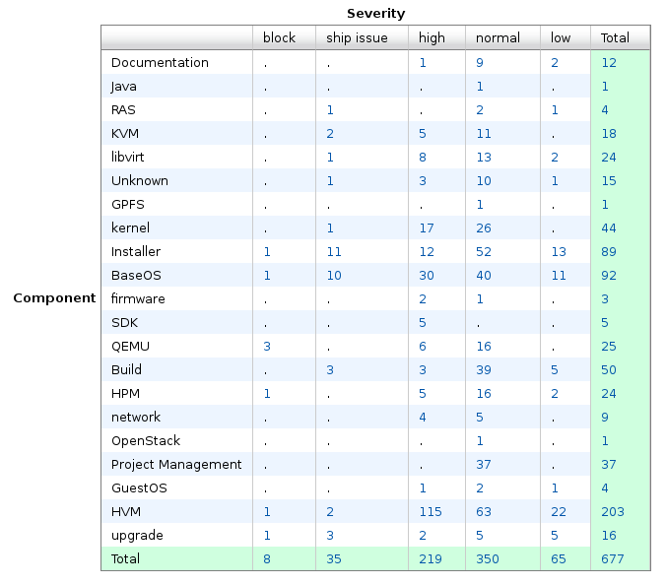
Vulcan – Bug Summary

Slide 6
Vulcan – Bug Summary

